Slide 1


Blockchain & Logistics
Fintech Project
iTrack
Anh Thi Dang
Tony Huang
Satoru Yamada
Jay Cao
GROUP B

Slide 2
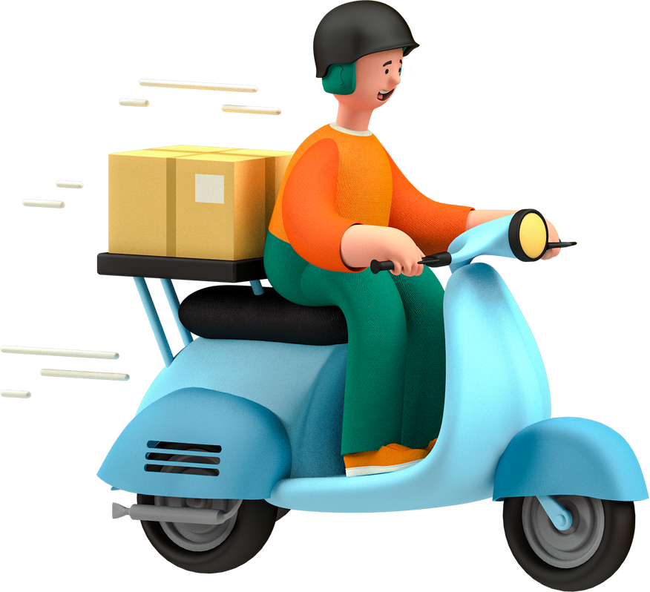

ABOUT US
We're a shipping company, providing global tracking services to our customers.
iTrack app is a tracking service that utilizes blockchain to help courier and customers to track shipping items.

Slide 3
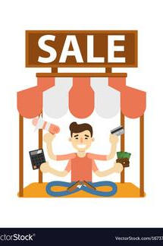


How iTrack works
Sellers, Couriers and Customers will be iTrack users
SELLERS/ADMIN
COURIERS
CUSTOMERS
Admin controls the contract, and will be able to whitelist courier and user address, while also being able to log and track shipping information
The courier has ability to log shipping information using IPFS onto the blockchain.
The user will be able track the item only.

Slide 4
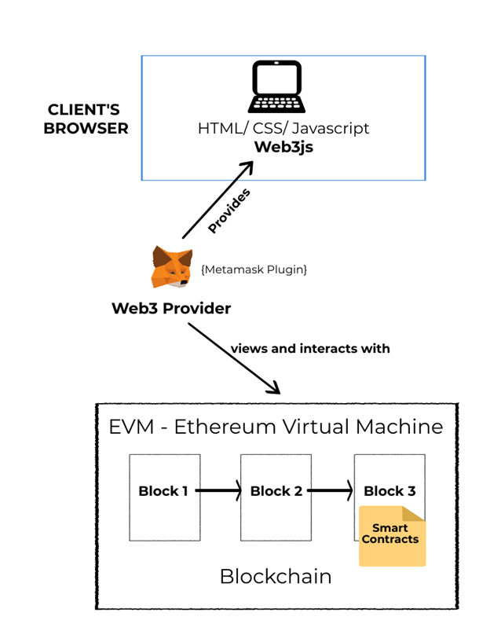


Slide 5






Technologies Employed
Ethereum - the most popular decentralised platform for smart contract
IPFS - a peer-to-peer hypermedia protocol designed to preserve and grow humanity's knowledge by making the web upgradeable, resilient, and more open
Web3js – is a collection of libraries that allow us to interact with a local or remote ethereum node using HTTP, IPC or WebSocket.
HTML - standard markup language for documents designed to be displayed in a web browser
JavaScript - one of the core technologies of the World Wide Web, alongside HTML and CSS
CSS - is used for defining the styles for web pages.

Slide 6
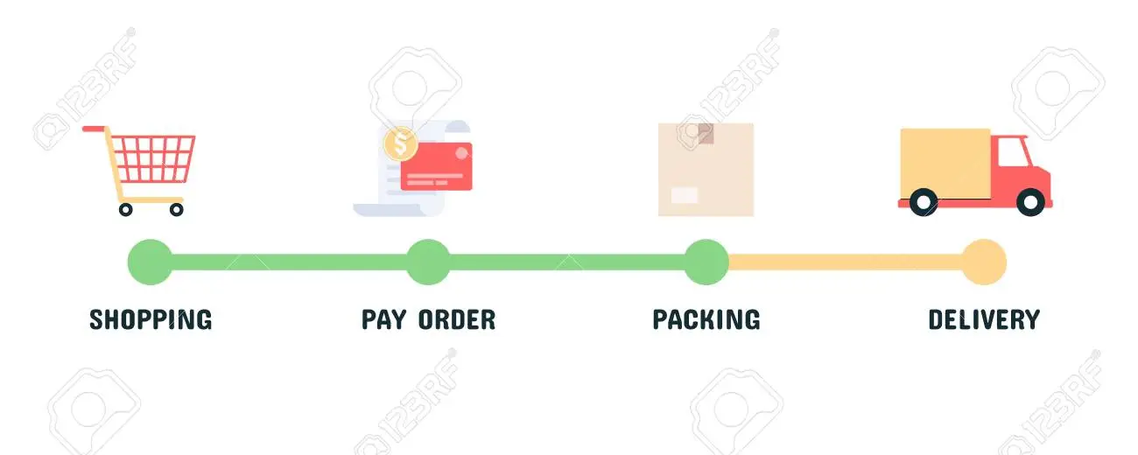
How we build iTrack
STEP 0
Deploy smart contract
By deploying on a account the admin will default to that particular account whereby it will have access to full functionality.
STEP 1
STEP 3
STEP 5
Add Courier
We can add courier (hash accounts) so that only Couriers can update the status of the parcel.
Add Parcel
Only couriers can add a new parcel for tracking
Track Status
Customers can view but not update the full history of the parcel's life cycle.
STEP 2
STEP 4
Update Status
Couriers can update the status of the parcel many times during the life cycle of the logistics.
Add Customer
Add customer (hash accounts) so that customers can view the statuses of their parcel(s).

Slide 7
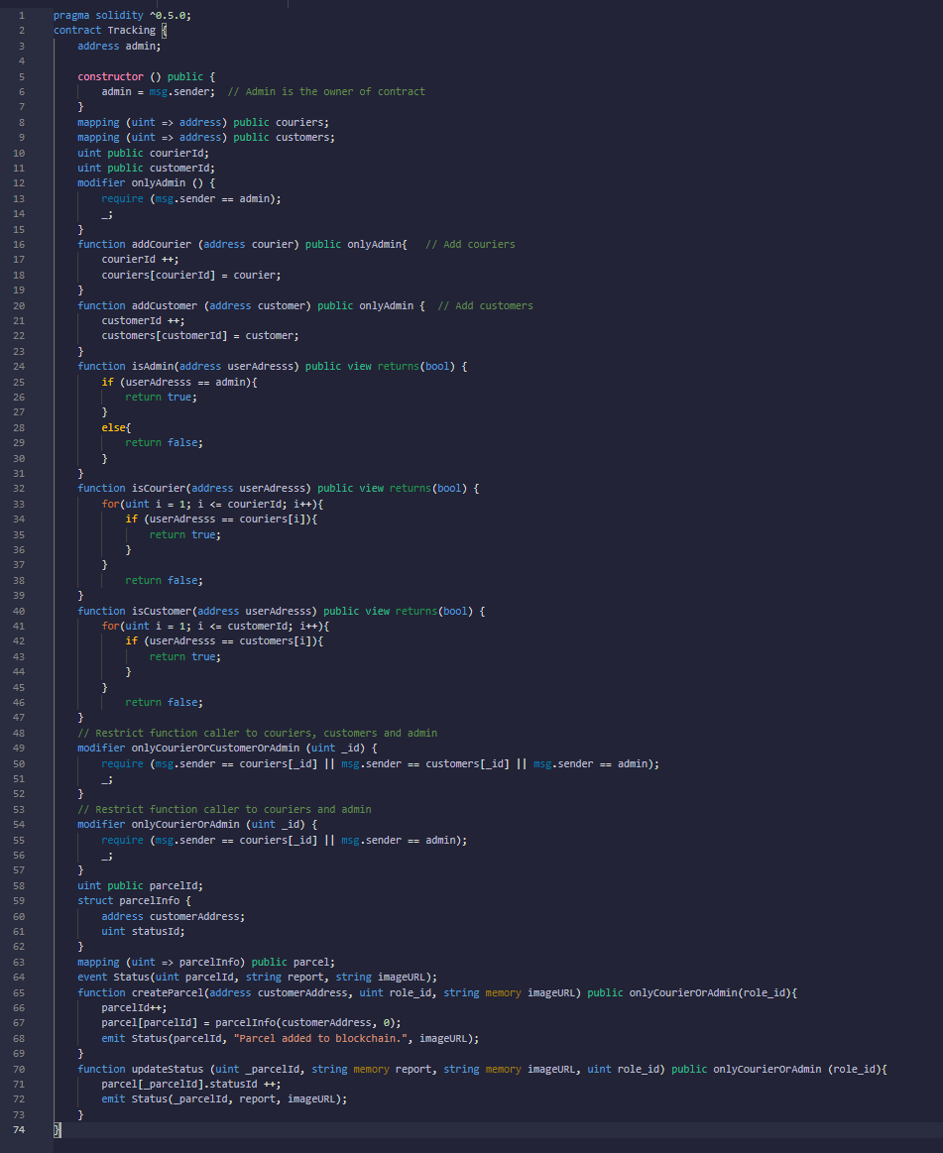

Smart Contracts

Slide 8

DEMO

Slide 9

Improvements
Functionalities - add more admins, duplicate checking for couriers/customers
Adding marketplace - users can exchange products and logistics becomes a feature of the marketplace, i.e ebay, shopify.
Handling of payments - using blockchain technology to handle payments between the sellers and buyers.
Acquiring barcode function - couriers and customers can scan to tracking shipping items.
Creating address (mnemonics) for each parcel as the tracking number.

Slide 10


Do you have any questions?

Slide 11



Thank you!

